Slide 1
AngularJS part 6
Arul

Slide 2
Topics
Routing
Testing
Animation

Slide 3
Routing
Routing is one of the angular module, Taking full advantage of client-side routing in your Angular apps will lead to better structured code and a better experience for your users,
https://docs.angularjs.org/api/ngRoute

Slide 4
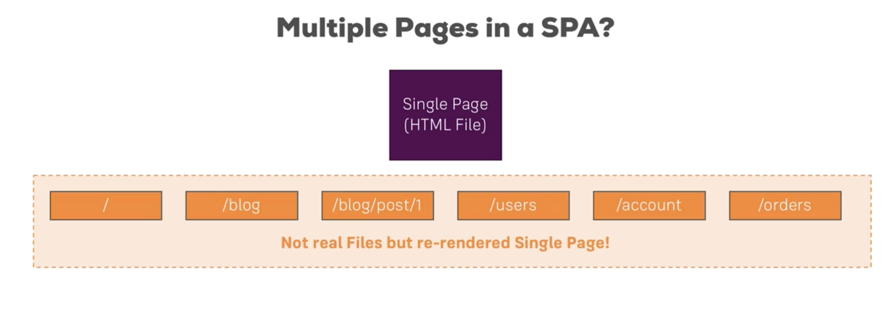

Slide 5
Route Module Components
Directive:
Ng-view - ngView is a directive,every time the current route changes, the included view changes with it according to the configuration of the $route service.
Service:
$route - $route is used for deep-linking URLs to controllers and views (HTML partials). It watches $location.url() and tries to map the path to an existing route definition.
$routeParams - The $routeParams service allows you to retrieve the current set of route parameters.
Provider Object
$routeProvider - Used for configuring routes.
npm install --save angular-route@X.Y.Z

Slide 6
Routing Configuration
angular.module("blogApp")
.config(function($routeProvider,$locationProvider){
$routeProvider
.when('/blog',{
templateUrl:"blog/blog.view.html",
controller:"blogController"
})
.when('/blog/:id',{
templateUrl:"singlePost/singlePost.view.html",
controller:"singlePostController"
})
.otherwise({
redirectTo: '/blog'
});
$locationProvider.html5Mode(true);
})
<div class="col-md-8 view-animate-container">
<div class="view-animate" ng-view ></div>
</div>

Slide 7
Accessing Route Param inside Controller
angular.module("blogApp")
.controller("singlePostController",['$scope','$route','$routeParams',singlePostController]);
function singlePostController($scope,$route,$routeParams){
$scope.selectedPostId = $routeParams.id;
}

Slide 8
Testing
AngularJS is written with testability in mind because JavaScript is a dynamically typed language which comes with great power of expression, but it also comes with almost no help from the compiler. For this reason we feel very strongly that any code written in JavaScript needs to come with a strong set of tests.
AngularJS has many built-in features which makes testing your AngularJS applications easy
Unit Test - Unit testing, as the name implies, is about testing individual units of code.

Slide 9
Karma
Karma is a test runner provided by the Angular team, Karma will execute your tests in multiple browsers which shall ensure that our application is compatible in all browsers.

Slide 10
Jasmine
describe('sorting the list of users', function() { it('sorts in descending order by default', function() { var users = ['jack', 'igor', 'jeff']; var sorted = sortUsers(users); expect(sorted).toEqual(['jeff', 'jack', 'igor']); }); });
Jasmine is a javascript unit testing framework and will provide us with utilities to test our application. We can use any other javascript testing framework for our testing but we’ll stick to jasmine as it is the most popular.

Slide 11
angular-mocks
AngularJS also provides the ngMock module, which provides mocking for your tests. This is used to inject and mock AngularJS services within unit tests. In addition, it is able to extend other modules so they are synchronous. Having tests synchronous keeps them much cleaner and easier to work with. One of the most useful parts of ngMock is $httpBackend, which lets us mock XHR requests in tests, and return sample data instead.

Slide 12
Steps for Test Configuration
Install Karma : npm install -g karma --save-dev
Install Jasmine : npm install karma-jasmine jasmine-core --save-dev
Install ngMock : npm install angular-mocks --save-dev
Install Browser : npm install karma-chrome-launcher --save-dev
karma.conf.js

Slide 13
describe('Filters Test', function () {
'use strict';
var $filter;
beforeEach(function () {
module('blogApp');
inject(function (_$filter_) {
$filter = _$filter_;
});
});
it('should convert array to string', function () {
// Arrange.
var arrayList = [{name:"Arul"},{name:"David"}]
// Act.
var result = $filter('arrayToFormattedString')(arrayList, 'name',',');
console.log(result);
// Assert.
expect(result).toEqual('Arul,David');
});
});

Slide 14
Animation
The ngAnimate module provides support for CSS-based animations (keyframes and transitions) as well as JavaScript-based animations via callback hooks. Animations are not enabled by default, however, by including ngAnimate the animation hooks are enabled for an AngularJS app.
https://docs.angularjs.org/api/ngAnimate

Slide 15
Other AngularJS Modules
Sice angularjs is open source , it has great developer community. Even If you not able to find some modules inside angularjs framework, You can find lot of reusable component from the developer community.
https://github.com/jirikavi/AngularJS-Toaster
http://ngmodules.org/

Slide 16
Thank you!
Happy Coding :)

